Slide 1
FLEXCO Wash-box

Slide 2
Advantages of Flexco Wash Box
Belt-washing systems are a proven method to remove residual material from conveyor belts to mandate high efficiency cleaning & thereby reducing losses due to carry backs. This also works in complying environmental issues, regulatory concerns etc.
Wash Box system ensures high degree of cleaning efficiency through our all the seasons of the year.
It provides ultimate cleaning efficiency on a range of conveyor systems.
Washing with Water improves the effectiveness of a cleaning system in a number of ways:
Water “softens” the bulk material, making it easier to remove.
b) Water keeps the belt-cleaner blades free from build-up, maximizing their cleaning efficiency.
c) Water reduces friction between the belt and cleaning blades, decreasing the forces that generate blade and belt wear, which improves the life expectancy of the Belt as well as blades and so extends the maintenance interval & huge saving in operating cost.

Slide 3
Features
We provide ultimate cleaning efficiency on a range of conveyor systems.
Each Wash box includes a combination of pressure rollers, spray bars and a recovery system.
We Provides Single Cleaner System and Dual Cleaner System also.
Single Cleaner System consist with One Belt Cleaner, One Return Roller, Mounting Hardware, Two Inspection Doors, complete side panel, one on each end of the enclosure. One Spray Bar with nozzles and valves, Centre Discharge Enclosure.
Double Cleaner System consist with Two belt Cleaners, Three Return Rollers, Mounting Hardware, Two Inspection Doors, complete side panel, one on each end of the enclosure, Four Spray Bars with nozzles and valves, Centre Discharge Enclosure.
Wash boxes are available for a range of Belt Widths up to 2000mm wide. Nonstandard sizes are also available on request.

Slide 4
Cleaning Process
The most effective way to clean a conveyor belt is with a belt washing system, often referred to as a wash-box. A belt wash-box is a proven method of removing residual material from conveyor belts in applications where environmental issues, regulatory concerns, or other problems mandate high-efficiency cleaning.
In the Belt Washing System, as the belt enters the wash-box a set of return idlers stabilizes the belt. Next, a spray bar uniformly sprays the load-carrying width of the belt with water, and the wash-box's first belt cleaner removes most of the residual material from the belt. (The water in the system can be substituted with anti-freeze or dust suppressant chemicals.) Finally, the wash-box's second belt cleaner removes the remaining residual material and begins to dry the belt. (After the wash-box, some variation of a belt drying system, from pressure rollers to squeegee blades to forced-air blowers, might follow, to completely dry the belt.)

Slide 5
Cleaning Process
In addition to the cleaning elements mentioned above, the Wash-box includes arrangements for handling the discharge of the effluent (the slurry of water and removed solids), and for the separation, recycling and/or disposal of the water and the removed material. The system also includes an enclosure, seals to prevent overspray, controls, and access doors to allow inspection and maintenance.
Our Wash-box is the ultimate in cleaning the belt - but it is designed to deal with only the final removal of any residual amount of material that passes the upstream cleaning equipment. We, therefore, recommend that at least one primary cleaner and one or two secondary cleaners be used on any conveyor where a wash-box is being considered. These cleaners - placed upstream (i.e. closer to the conveyor's discharge), of the point where the wash-box will be installed - will significantly reduce the amount of carry back to be removed in the wash-box, and result in substantial savings on water usage and operating costs. Without these cleaners, there will be too much carry back material to be removed from the belt by the wash-box, and, therefore, too many solids in the effluent.

Slide 6
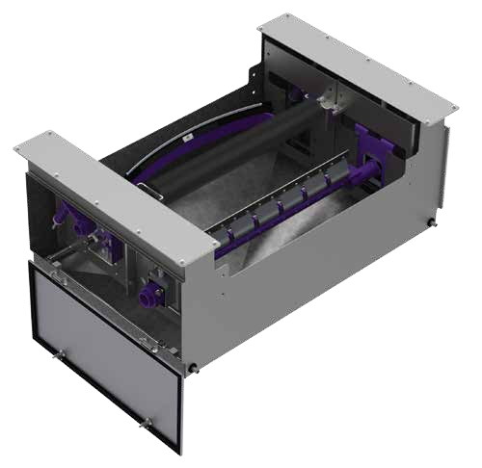
FLEXCO WASH BOX

Slide 7
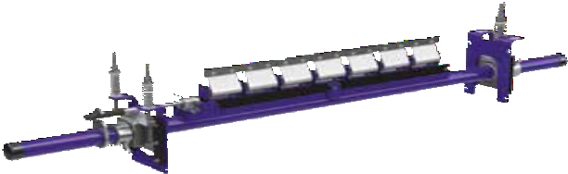
Heavy duty secondary cleaner

Slide 8
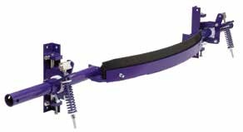
U-Type® Secondary Cleaner

Slide 9
CLEANER ADVANTAGES
A range of secondary cleaners to choose from
The Flexco Wash Box was designed to accommodate any two secondary cleaners from the Flexco range.
P-Type® Secondary Cleaner. A compact and reliable choice for maintaining a highly efficient cleaning system.
R-Type® Secondary Cleaner. Recommended for reversing belts, the R-Type is a versatile and effective choice – regardless of belt direction.
MHS Heavy-Duty Secondary Cleaner. Designed to deliver and maintain superior cleaning efficiency, even on the most demanding and abusive beltlines with long-lasting performance and low maintenance.
U-Type® Secondary Cleaner. Designed for constant blade-to-belt contact for the highest cleaning efficiency – especially in tough applications requiring removal of water and sticky carryback materials.

Slide 10
CLEANER ADVANTAGES
MHS Enhanced Service Advantage Cartridge Heavy-Duty Secondary Cleaner. The superior cleaning efficiency of the proven MHS Secondary Cleaner with the added benefit of superior, service-friendly cartridge removal.
P-Type® Enhanced Service Advantage Cartridge Heavy-Duty Secondary Cleaner.
Combines the compact and effective P-Type Secondary Cleaner with the easy-to-use cartridge kit.
R-Type® Enhanced Service Advantage Cartridge Heavy-Duty Secondary Cleaner. A versatile combination of the reversing R-Type Secondary Cleaner with the simple installation and maintenance of the cartridge kit.

Slide 11
FLEXCO WASH BOX
Superior Belt Washing for the Toughest Conveying Systems.
The Flexco Wash Box is designed to deliver superior cleaning efficiency in applications where the conveyor must be very clean or when head-end cleaning is not enough. Mounted on the return side of the belt, Flexco Wash Boxes are available in galvanized or stainless steel and are equipped with an adjustable hold down roller. Purchased separately from the Wash Box, two belt cleaners can be selected specifically for your application or your budget. Add return side spray bars, and the Flexco Wash Box system provides a high-efficiency customized belt cleaning solution for even the toughest applications.

Slide 12
THANK YOU

